Slide 1
Lock-Free and Wait-Free Memory Reclamation
Pedro Ramalhete
Cisco Systems
pramalhe@gmail.com
October 2016

Slide 2
Table of Contents Lock-Free and Wait-Free Memory Reclamation
GC vs reclaiming your own memory
Reference counting
Hazard Pointers
RCU (Epoch-based)
Hazard Eras
Other techniques and variations
Comparison

Slide 3
Terminology
Lock-Free: A method is Lock-Free if it guarantees that infinitely often some thread calling this method finishes in a finite number of steps.
Wait-Free Unbounded: A method is Wait-Free Unbounded if it guarantees that every call finishes its execution in a finite number of steps for which the bound is not known.
Wait-Free Bounded: A method is Wait-Free Bounded if it guarantees that every call finishes its execution in a finite and bounded number of steps. This bound may depend on the number of threads.
Readers: In the context of memory reclamation, refers to threads executing methods of the data structure that read or traverse portions of the data structure but do not delete any object
Reclaimers: In the context of memory reclamation, refers to threads executing methods that may traverse the data structure and delete objects/nodes in it

Slide 4
What is the problem?

Slide 5
Memory Reclamation
Memory Reclamation or Object Lifetime Tracking or Memory Reusage or Memory Management is the problem of when is it safe to free()/delete an object in a multithreaded application.
According to Concurrency experts like Maurice Herlihy and Erez Petrank, this is the biggest open problem in Concurrency, and probably the hardest.
Can Parallel data structures rely on automatic memory managers? - http://safari.ece.cmu.edu/MSPC2012/erez_abstract.pdf
Why Concurrent Data structures are still hard - http://www.etaps.org/index.php/2014/invited-speakers#ESOP
If this isn’t the hardest problem in Concurrency, it is certainly one of the hardest

Slide 6
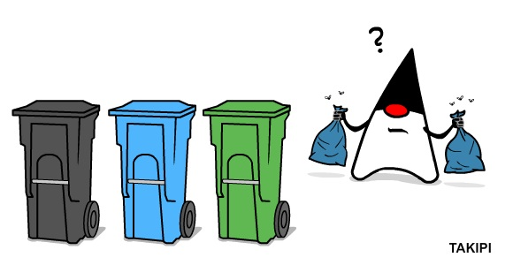
Types of Memory Reclamation
Memory Reclamation divides into automatic and manual.
Automatic is what we call Garbage Collection.
Manual is divided into three main groups:
Reference Counting: Counts the number of references to an object being held by the other threads (Atomic Reference Counting)
Pointer-based: Tracks which pointers are being used by other threads (Hazard Pointers, Pass The Buck, Drop The Anchor)
Quiescent-based: Waits for other threads to complete or enter a quiescent state (RCUs, Epoch)

Slide 7
Manual Memory Reclamation methods galore
There are many different techniques to track object lifetime and safely delete an object. We are going to cover only the main ones and all of these have the following properties:
They are partially or completely non-blocking (i.e. lock-free or wait-free)
They solve the ABA problem correctly
They can be implemented using atomics and the C11/C++1x Memory Model
We will not talk about other techniques which use some special hardware instructions, or posix signals, or require kernel support, or other architecture-specific trick. This talk is only about generic techniques to solve the memory reclamation problem.
… even so, I may have missed some more obscure techniques

Slide 8
GC versus reclaiming your own memory

Slide 9
GC or not GC?
Some systems/languages have an automatic Garbage Collector. Examples are D, Java and all languages on the JVM (Scala, Clojure), Python, Lua.
Other languages don’t have one by default but it is possible to add one. Examples are C/C++
There is one (and only one) algorithm by Herlihy and Moss for a lock-free GC. It dates back to 1992 and that I know of, no one ever used it because it’s too slow: http://dl.acm.org/citation.cfm?id=629088
As of today, there is no algorithm for a wait-free GC. This means that any wait-free data structure that uses a GC is not truly wait-free. It’s not just about the call to new triggering a GC run that may block the entire application, it’s the fact that the GC can enter at any time and prevent any or all threads from progressing. It’s about not having determinism.
All currently used GCs are blocking, although some are concurrent and have low latency. The best example I know of is the GC in the Zing JVM.
Even if one day someone discovers and implements a wait-free GC, what about the work that it needs to do?

Slide 10
Automatic memory reclamation (GC)
Pros
Algorithms for concurrent data structures are (much) simpler when you have a GC
The work of cleaning up the garbage can be delayed until a time when the system is not busy, thus improving overall throughput
Doing memory reclamation in bursts increases cache locality which improves throughput
Cons
Some of the complexity is hidden away and it can have some unexpected behaviors
Tail latency can be fat due to stop-the-world pauses, or safepoints, or too much work to be done by the GC thread(s)
Non-deterministic behavior of the application: A thread tries to allocate memory, there is none available and this triggers a full GC run. This thread may be doing something completely unrelated to the data structure that caused all the garbage to exist!

Slide 11
Manual memory reclamation (RCU, HP, RefCount, etc)
Pros
Memory is reclaimed when you intend it to
Behavior of the application is deterministic.
Typically no fat tail in the latency distribution (at least for pointer-based and refcount).
Cons
Data structures that reclaim their own memory are typically more complex
Choosing the right memory reclamation technique for the particular case can be difficult
Pointer-based memory reclamation is very tricky to deploy* correctly (HP, Pass the Buck, Drop the Anchor)
*by deploy we mean applying the memory reclamation scheme to your data structure

Slide 12
Code with GC is simpler
T* dequeue(const int TID) {
long long phase = maxPhase(TID) + 1;
state[TID].store(new OpDesc(phase, true, false, nullptr));
help(phase, TID);
help_finish_deq(TID);
OpDesc* curDesc = hpOpDesc.protect(kHpODCurr, state[TID], TID);
Node* node = curDesc->node;
if (node == nullptr) {
hpOpDesc.clear(TID);
hpNode.clear(TID);
OpDesc* desc = state[TID].load();
for (int i = 0; i < MAX_THREADS; i++) {
if (state[TID].compare_exchange_strong(desc, OPDESC_END)) break;
desc = state[TID].load();
if (desc == OPDESC_END) break;
}
hpOpDesc.retire(desc, TID);
return nullptr;
}
Node* next = node->next;
T* value = next->item.load();
next->item.store(nullptr); // "next" can be deleted now
hpOpDesc.clear(TID);
hpNode.clear(TID);
hpNode.retire(node, TID);
OpDesc* desc = state[TID].load();
for (int i = 0; i < maxThreads*2; i++) { // Is maxThreads+1 enough?
if (desc == OPDESC_END) break;
if (state[TID].compare_exchange_strong(desc, OPDESC_END)) break;
desc = state[TID].load();
}
hpOpDesc.retire(desc, TID);
return value;
}
The Java code below uses GC and is the dequeue method of a wait-free queue by Alex Kogan and Erez Petrank which takes just 9 lines.
The C++ code on the right is exactly the same algorithm using Hazard Pointers (30 lines)
Both listings have the same font
public E dequeue(final int TID) {
long phase = maxPhase() + 1;
state.set(TID, new OpDesc<E>(phase, true, false, null));
help(phase);
help_finish_deq();
final Node<E> node = state.get(TID).node;
if (node == null) return null;
final E value = node.next.value;
node.next = node;
return value;
}
Java with GC
C++ with HP

Slide 13
GCs are non-deterministic
Suppose you have the scenario on the right
Even though it’s Thread 1 that is creating all the garbage, it will be when Thread 2 is executing that the GC will run, thus impacting latency and throughput of whatever Thread 2 is doing
Maybe it is not even doing memory allocation but the GC decides it’s time to do a full run
Thread 1 -> nonCriticalWorkThatCreatesALotOfGarbage()
T1 has almost exhausted all memory available to the app and then an outside event (an incoming network packet, or a timer) causes thread 2 to call the method below:
Thread 2 -> superImportantWorkThatDoesASingleAllocation()
This method runs out of memory and triggers a full GC run which can take seconds to complete

Slide 14

Can a GC keep up with all the garbage that is produced?
Suppose you have a machine with 64 cores where you have 31 threads doing enqueues in a concurrent queue and 31 threads doing dequeues.
There are 2 cores left for the system and the garbage collection to run on.
Will the 2 cores be enough to scan the memory searching for unused (dequeued) nodes and reclaim them faster than the 31 cores are at dequeueing the nodes?
GC with generation typically only scan the new generation, but eventually will need to scan older generations.
How many cores does the GC need? 1, 2, 10, 31, 64, even more ?
If we don’t reserve those cores then, there will be moments in time where either the latency is going to be hit pretty badly (tail latency) or the memory is going to blow up
It’s a trade-off: either you waste resources or you risk crashing the application
Sure, this happens only on high contention scenarios, but suddenly, a GC doesn’t look that good anymore, does it?

Slide 15
Quiz 1
Which of the following sentences are true of Automatic Garbage Collectors (GC)?
All languages/runtimes with a GC implementation, are blocking
There is a wait-free GC algorithm but no one uses it because it’s too slow
Implementing a wait-free data structure in a language with a GC may result in having a fat tail in the latency distribution
As long as I don’t do memory allocation or produce garbage in a method of my application, the GC won’t affect it’s latency or throughput
True | False

Slide 16
Quiz 1
Which of the following sentences are true of Automatic Garbage Collectors (GC)?
All languages/runtimes with a GC implementation, are blocking
There is a wait-free GC algorithm but no one uses it because it’s too slow
Implementing a wait-free data structure in a language with a GC may result in having a fat tail in the latency distribution
As long as I don’t do memory allocation or produce garbage in a method of my application, the GC won’t affect it’s latency or throughput
True | False

Slide 17
Reference Counting

Slide 18
Reference Counting
Using reference counting to track the lifetime of an object is a concept that most software developers are familiar with (smart pointers). In the multi-threaded context this means something slightly different, therefore, we’ll call it Atomic Reference Counting to distinguish the two techniques
Atomic Reference Counting was originally presented by John Valois in 1995 in a paper named “Lock-Free Linked Lists Using Compare-And-Swap”
http://people.csail.mit.edu/bushl2/rpi/portfolio/lockfree-grape/documents/lock-free-linked-lists.pdf
They have been recently introduced in the C++ standard by Herb Sutter under the name Atomic Smart Pointers
http://www.open-std.org/jtc1/sc22/wg21/docs/papers/2014/n4058.pdf
A nice post by Bartosz Milewski
https://bartoszmilewski.com/2009/08/19/the-anatomy-of-reference-counting/

Slide 19
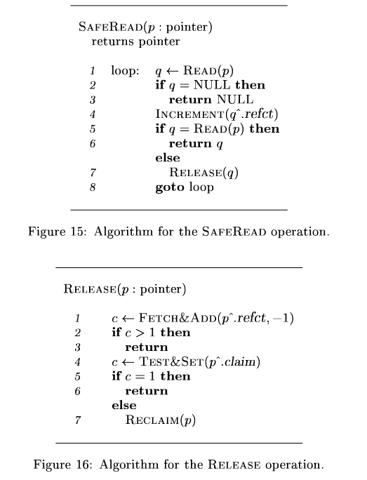
Reference Counting How it works
When we get a pointer to an object that is tracked by refcount, we do an atomic increment in it, for example, with atomic_fetch_add()
Whenever we’re no longer using it, we decrement it atomically, for example, when the variable goes out of scope.
The thread that decrements the refcount to zero is responsible for deleting the object (i.e. reclaiming the memory).
Notice that the atomic increment and decrement can be done with a CAS

Slide 20
Reference Counting It’s not as easy as it looks…
Value_t* getBad(Key_t* key) {
Value_t* val = findInHashMap(key);
atomic_fetch_add(&val->refcnt, 1);
return val;
}
Value_t* getGood(Key_t* key) {
pthread_mutex_lock(&mutex);
Value_t* val = findInHashMap(key);
atomic_fetch_add(&val->refcnt, 1);
pthread_mutex_unlock(&mutex);
return val;
}
Value_t* removeGood(Key_t* key) {
pthread_mutex_lock(&mutex);
Value_t* val = removeFromHashMap(key);
if (atomic_fetch_add(&val->refcnt, -1) == 1) {
free(val);
}
pthread_mutex_unlock(&mutex);
return val;
}
What happens if one thread gets a pointer to the object and before it gets a chance to increment refcount, the last thread stops, decrements to zero and deletes the object?
Answer: a nasty crash!
There are two ways around this problem:
Always access the object through an object that is managed some other way, typically a lock. For example, when the only way to get the pointer to the object is through an hashmap and the hashmap is itself protected by a mutex, then it’s safe.
Have a wrapper object that encapsulates the refcount variable and the pointer to the object instead of having the refcount inside the object itself. This creates the problem that now you may have to track the lifetime of the wrapper object, and if you do, will you use atomic recount?

Slide 21
Atomic Reference Counting Example with a linked list
W
head
node A
node B
node C
node D
node E
tail
refct = 2
refct = 2
refct = 2
refct = 2
refct = 1
refct = 1
refct = 1
refct = 2
refct = 1
refct = 1
Readers
Read pointer
Increment a refct in the object
Use the object
Decrement a refct in the object
If the refct reaches zero then delete the object
R

Slide 22
Atomic Reference Counting Example with a linked list
W
We’re not showing the increment/decrement by the Reclaimer as it traverses the list to simplify the animation
head
node A
node B
node D
node E
tail
refct = 2
refct = 1
refct = 1
node C
refct = 1
refct = 1
refct = 2
refct = 0
refct = 1
R
Reclaimers
Unlink the node
Decrement the refct in the object
If it gets to zero, delete the object

Slide 23
Reference Counting Disadvantages
Atomic Reference Counting is not really generic, if you use it you will still need a way to guarantee that the object is not deleted when the pointer is being read. This can be achieved with a mutex, but it kind of defeats the purpose, which is to have lock-free/wait-free memory reclamation
There are many usages in which atomic reference counting has issues (see section 9.1 of Paul McKenney’s book)
https://kernel.org/pub/linux/kernel/people/paulmck/perfbook/perfbook.2015.01.31a.pdf
Without a Double-Compare-And-Swap (DCAS) instruction, it is not possible to implement this in a non-blocking way, and therefore, this isn’t a portable technique.

Slide 24
Quiz 2
Consider the differences between Reference Counting and Atomic Reference Counting.
Which of the following sentences are true?
I can use a regular int refcount to keep track of objet usage in a multi-threaded application by doing refcount++ and refcount--
Whomever puts refcount at zero is responsible for doing delete of the object
In Atomic Reference Counting, reclaimers can be wait-free
In Atomic Reference Counting, readers can be wait-free
True | False

Slide 25
Quiz 2
Consider the differences between Reference Counting and Atomic Reference Counting.
Which of the following sentences are true?
I can use a regular int refcount to keep track of objet usage in a multi-threaded application by doing refcount++ and refcount--
Whomever puts refcount at zero is responsible for doing delete of the object
In Atomic Reference Counting, reclaimers can be wait-free
In Atomic Reference Counting, readers can be wait-free
True | False

Slide 26
Hazard Pointers

Slide 27
Hazard Pointers (HP)
Hazard Pointers were first published in 2004 by Maged Michael
https://www.research.ibm.com/people/m/michael/ieeetpds-2004.pdf
This work was inspired by the Pass-The-Buck and the Repeated-Offender-Problem by Maurice Herlihy and Nir Shavit
Hazard Pointers are lock-free for readers but sometimes can be implemented wait-free for readers, and they’re wait-free bounded for reclaimers
HP requires an array of atomic pointers with at least one entry per thread where each thread publishes the pointers that is currently using.
HP is memory bounded, which is great in embedded devices. They give the guarantee that at most MAX_THREADS x MAX_HPS x R objects are retired and still waiting to be deleted.
HP is a pointer-based memory reclamation technique

Slide 28
Hazard Pointers Components
Array with NUM_HPS entries per thread
Thread-local list of retired objects
An R factor that is a multiplier to control the number of objects to be in the retired list
std::atomic<T*> hp[HP_MAX_THREADS][HP_MAX_HPS];
std::vector<T*> retiredList[HP_MAX_THREADS];

Slide 29
Hazard Pointers C++ implementation
T* protect(int index, const std::atomic<T*>& atom, const int tid) {
T* n = nullptr;
T* ret;
while ((ret = atom.load()) != n) {
hp[tid][index].store(ret);
n = ret;
}
return ret;
}
The protect() method protects an hazardous pointer
The clear() method clears out an entry in the arrays of hazard pointers
The retire() method after scanning the array of hazard pointers, will delete the node/object if it’s not being used, otherwise defer its deletion
void clear(int ihp, const int tid) {
hp[tid][ihp].store(nullptr, std::memory_order_release);
}
void retire(T* ptr, const int tid) {
retiredList[tid].push_back(ptr);
if (retiredList[tid].size() < HP_THRESHOLD_R) return;
for (unsigned iret = 0; iret < retiredList[tid].size();) {
auto obj = retiredList[tid][iret];
bool canDelete = true;
for (int tid = 0; tid < maxThreads && canDelete; tid++) {
for (int ihp = maxHPs-1; ihp >= 0; ihp--) {
if (hp[tid][ihp].load() == obj) {
canDelete = false;
break;
}
}
}
if (canDelete) {
retiredList[tid].erase(retiredList[tid].begin() + iret);
delete obj;
continue;
}
iret++;
}
}
}

Slide 30
Hazard Pointers Example with a linked list
Thead 1
Thead 2
Thead 3
Thead 4
Thead …
W
hp array
nullptr
nullptr
nullptr
nullptr
nullptr
node A
node C
node E
node D
nullptr
nullptr
nullptr
nullptr
nullptr
node B
head
node A
node B
node C
node D
node E
tail
R
Readers
Read pointer
Store pointer in hp array
Read pointer again to check it hasn’t changed

Slide 31
Hazard Pointers Example with a linked list
Thead 1
Thead 2
Thead 3
Thead 4
Thead …
W
hp array
node C
nullptr
nullptr
nullptr
nullptr
node B
nullptr
nullptr
nullptr
nullptr
node C
head
node A
node B
node D
node E
tail
R
Reclaimers
Unlink the node
Scan arry of hazard pointers looking for the node
If node is being used, put it in retired list

Slide 32
Hazard Pointers Preventing the ABA problem
We’ve talked about ABA before https://en.wikipedia.org/wiki/ABA_problem
Hazard Pointers are capable of preventing ABA issues with memory reclamation due to an object getting removed-deleted-created-inserted
An object that is protected by a (validated) hazard pointer can not be deleted, and therefore, a new different object can not be created in the same memory location and then inserted back in the data structure, causing a CAS to succeed when it shouldn’t
Hazard Pointers do not prevent all ABA issues, only the issues pertaining to memory reclamation. It is up to each algorithm or data structure to take care of ABA on its own.

Slide 33
Hazard Pointers Disadvantages
Hazard Pointers require a deep knowledge of the algorithm where they’re being embedded on. Many designers of lock-free/wait-free data structures don’t bother to put the code for the HPs (unless it’s really easy like in the Michael-Scott list), and instead assume that there is a GC, or that the implementer is smart enough to add the HPs in the appropriate places… i.e. smarter than them
Hazard Pointers require at least one entry in an array per thread. This means we need to know a-priori the maximum number of threads in the application. If threads are created/destroyed at runtime, then we need another mechanism to give unique entries in the array to each thread, and the mechanism must be lock-free. Not impossible but it starts to get complicated.
Hazard Pointers are lock-free for readers, and we already showed that for tail latency, lock-free isn’t good enough.

Slide 34
Quiz 4
Suppose you’re using a Harris list where all three method where contains()/add()/remove() are lock-free and you are implementing it in C/C++, and decide to use Hazard Pointers. What are the progress conditions of each method after you have added Hazard Pointers to Harris list?
Blocking | Lock-Free | Wait-Free Bounded
contains() (read-only)
add() (mutative)
remove() (mutative)

Slide 35
Quiz 4
Suppose you’re using a Harris list where all three method where contains()/add()/remove() are lock-free and you are implementing it in C/C++, and decide to use Hazard Pointers. What are the progress conditions of each method after you have added Hazard Pointers to Harris list?
Blocking | Lock-Free | Wait-Free Bounded
contains() (read-only)
add() (mutative)
remove() (mutative)

Slide 36
URCU Memory Reclamation

Slide 37
RCU
When people talk about RCU it usually means one (or both) of two things: RCU-technique and RCU-epoch. The RCU-technique is what we talked on a previous presentation and named it Copy-On-Write (COW), and the RCU-epoch is what allows to do concurrent memory reclamation. From now on, all mentioning of RCU refers to RCU-epoch
RCU is the oldest of memory reclamation techniques and also the simplest
Although there are previous papers with similar ideas dating back to 1970, in its present form, it was originally designed by Paul McKenney and John Slingwine and published in 1998 http://www.rdrop.com/~paulmck/RCU/rclockpdcsproof.pdf
Trivia: One of the first persons that Paul McKenney showed RCU to was Maged Michael (the guy who later invented Hazard Pointers)
We’re going to talk about Userspace RCU. There is also the Linux Kernel implementation but that is slightly different beast.
There are many algorithms for implementing RCU. Depending on the algorithm chosen, RCU can be wait-free population oblivious for readers and it’s always blocking for reclaimers (can be starvation-free).

Slide 38
What makes RCU so special?
RCU’s true magic comes from three characteristics:
It does very little synchronization (providing excellent throughput for the readers);
It has wait-free population oblivious progress for the readers (providing excellent tail latency for the readers);
It is very easy to deploy it in any new algorithm you chose to;
Throughput
The amount of synchronization is small and constant, i.e. does not depend on the number of nodes/objects traversed
Latency
Readers are wait-free population oblivious. They have very deterministic latency and no fat tail
Reclaimers are blocking but they can be scalable and starvation-free, which provides good latency for several usages
Deploying RCU on your own algorithm or data structure is just a matter of
Calling rcu_read_lock() at the beginning of each method;
Calling rcu_read_unlock() in every exit path;
When memory reclamation is needed, after the object is no longer accessible, call synchronize_rcu() and then it will be safe to call free() or delete on the object;

Slide 39
Simple URCU implementation in C++
class URCUReadersVersion {
const int64_t NOT_READING = std::numeric_limits<int64_t>::max();
std::atomic<int64_t> reclaimerVersion = { 0 };
std::atomic<int64_t> readersVersion[URCU_MAX_THREADS]
public:
URCUReadersVersion() {
for (int i=0; i < URCU_MAX_THREADS; i++) {
readersVersion[i].store(NOT_READING, std::memory_order_relaxed);
}
}
void read_lock(const int tid) { // rcu_read_lock()
const int64_t rv = reclaimerVersion.load();
readersVersion[tid].store(rv);
const int64_t nrv = reclaimerVersion.load();
if (rv != nrv) readersVersion[tid].store(nrv, std::memory_order_relaxed);
}
void read_unlock(const int tid) { // rcu_read_unlock()
readersVersion[tid].store(NOT_READING, std::memory_order_release);
}
void synchronize_rcu() {
const int64_t waitForVersion = reclaimerVersion.fetch_add(1)+1;
for (int i=0; i < URCU_MAX_THREADS; i++) {
while (readersVersion[i].load() < waitForVersion) { } // spin
}
}
};
With just these 10 lines of code we get a working concurrent memory reclamation API that scales well, is easy to deploy, and needs just the C11/C++11 memory model to be used.

Slide 40
Deploying URCU in a set
bool contains(T* item) {
rcu_read_lock();
bool foundItem = containsAlgorithmCode(item);
rcu_read_unlock();
return foundItem;
}
bool remove(T* item) {
rcu_read_lock();
Node<T*> node = removeAlgorithmCode(item);
if (node == nullptr) {
rcu_read_unlock();
return false;
}
rcu_read_unlock();
synchronize_rcu();
delete node;
return true;
}
bool add(T* item) {
rcu_read_lock();
bool foundItem = addAlgorithmCode(item);
rcu_read_unlock();
return foundItem;
}

Slide 41
URCU Example with a linked list
Thead 1
Thead 2
Thead 3
Thead 4
Thead …
W
3260
-1
-1
-1
-1
versions array
-1
Global version
3260
head
node A
node B
node C
node D
node E
tail
Readers
Read a global version
Store the version in the versions array
Read whatever is needed without worries
Remove the version from the versions array
R

Slide 42

URCU Example with a linked list
Thead 1
Thead 2
Thead 3
Thead 4
Thead …
-1
-1
-1
-1
-1
W
versions array
3260
Global version
3261
3260
head
node A
node B
node D
R
node E
tail
node C
Reclaimers
Unlink the node
Increment the global version
Wait for all readers to complete or have a higher version
Delete the node

Slide 43
URCU with deferral
Why wait for all the readers to complete? Why not use the same technique as Hazard Pointers of putting the node/object in a list of retired object?
We can do it, and URCU supports it with the API call_rcu()
… the problem is that there is no bound on the number of objects that may be passed to call_rcu(), and no bound means no limit on the amount of memory that is needed to store all these nodes (and the associated list)
Pop quiz: How much memory do we need to store the undeleteable nodes passed to call_rcu() ?
None
MAX_THREADS
The number of objects in the linked list that is being traversed
Infinite

Slide 44
URCU Disadvantages
One sleepy or dead Reader is enough to prevent all further memory reclamation
Reclaimers are blocking because they call synchronize_rcu() and although it is possible to defer memory reclamation to a later time, it is just making the tail latency worse

Slide 45
Quiz 5
Suppose you’re using a Michael-Scott lock-free list (all methods are lock-free) and you are implementing it in C/C++, and decide to use URCU. What are the progress conditions of each method after you have added URCU to the Michael-Scott list?
Blocking | Lock-Free | Wait-Free Bounded
contains() (read-only)
add() (mutative)
remove() (mutative)

Slide 46
Quiz 5
Suppose you’re using a Michael-Scott lock-free list (all methods are lock-free) and you are implementing it in C/C++, and decide to use URCU. What are the progress conditions of each method after you have added URCU to the Michael-Scott list?
Blocking | Lock-Free | Wait-Free Bounded
contains() (read-only)
add() (mutative)
remove() (mutative)

Slide 47
Hazard Eras

Slide 48
Hazard Eras
Hazard Eras were made by Pedro Ramalhete and Andreia Correia and has not yet been published but it will be made public in http://www.concurrencyfreaks.com soon
Hazard Eras are a combination of Hazard Pointers with an epoch-based technique
They have the same API as Hazard Pointers and therefore can be used as a drop-in replacement to Hazard Pointers
They are lock-free (sometimes wait-free) for Readers, and wait-free unbounded for Reclaimers
Similarly to Hazard Pointers, Hazard Eras are memory bounded although with a higher bound
Hazard Eras are just as easy (hard) to use as Hazard Pointers

Slide 49
Hazard Eras Example with a linked list
Thead 1
Thead 2
Thead 3
Thead 4
Thead …
W
he array
3260
-1
-1
-1
-1
-1
3260
-1
-1
-1
-1
-1
Global era
3260
head
node A
node B
node C
node D
node E
tail
newEra = 3200
newEra = 123
newEra = 1
newEra = 3259
newEra = 2300
Readers
Read Pointer
Read global era
If era is different from the previously published era, publish the new era and go to 1.
R

Slide 50
Hazard Eras Example with a linked list (insertion)
Thead 1
Thead 2
Thead 3
Thead 4
Thead …
W
he array
-1
-1
-1
-1
-1
-1
-1
-1
-1
-1
Global era
3261
head
node A
node B
node D
node E
tail
newEra = 3200
newEra = 123
newEra = 3259
newEra = 2300
node C
newEra = 3261

Slide 51
Hazard Eras Example with a linked list (removal)
Thead 1
Thead 2
Thead 3
Thead 4
Thead …
W
he array
3260
-1
-1
-1
-1
3260
-1
-1
-1
-1
Global era
3261
3262
head
node A
node B
node D
node E
tail
newEra = 3200
newEra = 123
newEra = 3259
newEra = 2300
R
node C
delEra = 3261
Reclaimers
Unlink the node
Save the current era as delEra and increment the era
If there are no entries in the HE array with a value in the range between [newEra ; delEra] then it is safe to delete
newEra = 3261

Slide 52
URCU/Epoch versus Hazard Eras
Time
Reader A
Reader B
Reader C
Reader D
Reader E
1 2 3 4 5 6 7 8 9 10 11 12 13 14 15 16 17 18 19 20 21 22 23 24 25 26 27 28 29 30
1
-1
2
-1
4
-1
4
-1
13
…
With URCU/Epoch the readers publish the latest global epoch they have seen, and in the end they publish some special value to indicate they’re no longer active (-1 for example)
The algorithms can be slightly different but they always revolve around this concept
Reader C has published the epoch 4 even though there was a delay and by the time it published it was already at 7
Reader E has published 13 and then went to sleep for a a very long long time…

Slide 53
URCU/Epoch versus Hazard Eras
Time
Reader A
Reader B
Reader C
Reader D
Reader E
Node x
Node y
Node z
Node w
1 2 3 4 5 6 7 8 9 10 11 12 13 14 15 16 17 18 19 20 21 22 23 24 25 26 27 28 29 30
1
-1
2
-1
4
-1
4
-1
13
…
Which nodes are being prevented from being deleted by which readers?

Slide 54
URCU/Epoch versus Hazard Eras
Time
Reader A
Reader B
Reader C
Reader D
Reader E
Node x
Node y
Node z
Node w
1 2 3 4 5 6 7 8 9 10 11 12 13 14 15 16 17 18 19 20 21 22 23 24 25 26 27 28 29 30
1
-1
2
-1
4
-1
4
-1
13
…
x is being blocked by A, B, C
y is being blocked by D and E
z,w are being blocked by E

Slide 55
URCU/Epoch versus Hazard Eras
Time
Reader A
Reader B
Reader C
Reader D
Reader E
Node x
Node y
Node z
Node w
1 2 3 4 5 6 7 8 9 10 11 12 13 14 15 16 17 18 19 20 21 22 23 24 25 26 27 28 29 30
1
3
-1
2
3
5
6
7
10
-1
4
7
-1
4
-1
13
…
3
8
12
16
24
28
25
29
Which nodes are being prevented from being deleted by which readers?

Slide 56
URCU/Epoch versus Hazard Eras
Time
Reader A
Reader B
Reader C
Reader D
Reader E
Node x
Node y
Node z
Node w
1 2 3 4 5 6 7 8 9 10 11 12 13 14 15 16 17 18 19 20 21 22 23 24 25 26 27 28 29 30
1
3
-1
2
3
5
6
7
10
-1
4
7
-1
4
-1
13
…
3
8
12
16
24
28
25
29
x is blocked by A, B, C, D
y is blocked by E
z and w are not blocked by any reader
Even if reader E sleeps forever, no node created after era 13 will be blocked by it

Slide 57
Hazard Eras Disadvantages
Just like Hazard Pointers, Hazard Eras require a deep knowledge of the algorithm where it is being deployed
The memory bound is not as strong for Hazard Eras as for Hazard Pointers. The wrost-case bound for HE is the number of tracked objects allocated at a given time times MAX_THREADS.
An object tracked by HE needs a field named “newEra” to store the era of when it was created. The delEra can also be store in the object, or on a separate data structure.

Slide 58
Other techniques

Slide 59
Other techniques in the literature
Pass the Buck http://citeseerx.ist.psu.edu/viewdoc/download?doi=10.1.1.111.1952&rep=rep1&type=pdf
Similar to Hazard Pointers. Has two variants, one of them is not memory bounded.
Drop The Anchor http://www.cs.technion.ac.il/~sakogan/papers/spaa13.pdf
It’s a lightweight variation on Hazard Pointers. Even more difficult to apply than HP and maybe not possible in all data structures
Epoch-based by Harris https://timharris.uk/papers/2001-disc.pdf
A simplistic Userspace RCU approach where each thread publishes which global epoch that have seen. Nodes retired at a certain epoch may only be deleted if all active threads publish an higher epoch.
StackTrack http://people.csail.mit.edu/amatveev/StackTrack_EuroSys2014.pdf
Uses Hardware Transactional Memory (HTM)
ThreadScan http://people.csail.mit.edu/amatveev/ThreadScan_SPAA2015.pdf
Uses signals provided by the operating system (like Posix signals)

Slide 60
Wait-Free Hazard Pointers
void lockFreeMethod() {
Node* lhead = head.load();
do {
hp[mytid].store(lhead);
} while (lhead != head.load());
doSomethingWithHead(lhead);
} // May need infinite steps to complete
void waitFreeBoundedMethod() {
for (int istep=0; istep < maxSteps; istep++) {
Node* lhead = head.load();
hp[mytid].store(lhead);
if (lhead != head.load()) continue;
doSomethingWithHead(lhead);
break;
}
} // Completes in maxSteps
In situations where a wait-free data structure has an helping mechanism (all of wait-free data structures?) we can apply Hazard Pointers in a wait-free way even for readers
Hazard Pointers are typically applied in a lock-free loop of publishing/validation.
The trick to make them wait-free is to have the data structure’s algorithm provide the guarantee that the loop has a bound

Slide 61
Quiz 6
Suppose you’re using a wait-free queue which uses a helping mechanism where threads help each other to complete in a bounded number of steps.
From an algorithmic point of view, both enqueue() and dequeue() are wait-free bounded
What is the best possible progress conditions of each method after you have added Hazard Pointers to a wait-free queue?
Blocking | Lock-Free | Wait-Free Bounded
enqueue() (reader)
dequeue() (reclaims)

Slide 62
Quiz 6
Suppose you’re using a wait-free queue which uses a helping mechanism where threads help each other to complete in a bounded number of steps.
From an algorithmic point of view, both enqueue() and dequeue() are wait-free bounded
What is the best possible progress conditions of each method after you have added Hazard Pointers to a wait-free queue?
Blocking | Lock-Free | Wait-Free Bounded
enqueue() (reader)
dequeue() (reclaims)

Slide 63
Quiz 7
For the following manual memory reclamation techniques, classify each based on their family
Reference Counter based | Pointer based | Epoch based
Atomic Reference Counting
Hazard Pointers
RCU
Hazard Eras

Slide 64
Quiz 7
For the following manual memory reclamation techniques, classify each based on their family
Reference Counter based | Pointer based | Epoch based
Atomic Reference Counting
Hazard Pointers
RCU
Hazard Eras

Slide 65
Comparison

Slide 66
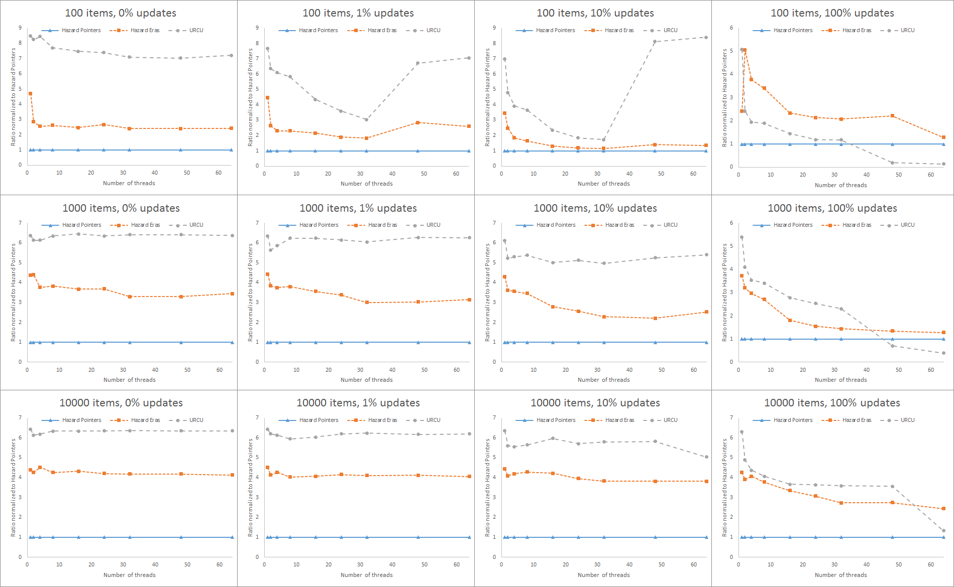
Comparing Hazard Pointers, URCU, and Hazard Eras applied to a Harris-Maged lock-free linked list

Slide 67
Comparison
 | Atomic Reference Counting | RCU / Epoch | RCU / Epoch with deferral | Hazard Pointers | Pass The Buck | Drop The Anchor | Hazard Eras
Readers Progress | wait-free population oblivious | wait-free population oblivious | wait-free population oblivious | lock-free (sometimes wait-free) | lock-free | lock-free (sometimes wait-free) | lock-free (sometimes wait-free)
Reclaimer Progress | wait-free | blocking | blocking | wait-free bounded | lock-free | wait-free bounded | wait-free unbounded
Readers Synchronization per node | 2 fetch_add() | none | none | 2 seq-cst load 1 seq-cst store | 2 seq-cst load 1 seq-cst store | 1 seq-cst load for regular nodes | 3 seq-cst load
Read Synchronization overhead | none | 2 seq-cst loads 2 seq-cst stores | 2 seq-cst loads 2 seq-cst stores | none | none | 2 seq-cst load 1 seq-cst store | O(threads) seq-cst stores
Max Nodes to be deleted | O(threads) | O(1) | infinite | O(threads x hps) | ? | O(threads x hps x nodes between an anchor) | Finite without known bound
Ease of deployment | normal | very easy | easy | hard | hard | very hard | hard
Observations | Doesn’t work for all cases |  | Can exhaust all memory

Slide 68
Comparison
 | Atomic Reference Counting | RCU / Epoch | RCU / Epoch with deferral | Hazard Pointers | Pass The Buck | Drop The Anchor | Hazard Eras
Readers Progress | ☺☺☺ | ☺☺☺ | ☺☺☺ | ☺☺ | ☺☺ | ☺☺ | ☺☺
Reclaimer Progress | ☺☺☺ | ☹☹☹ | ☹ | ☺☺☺ | ☺☺☺ | ☺☺☺ | ☺☺☺
Read Synchronization per node | ☹☹☹ | ☺☺☺ | ☺☺☺ | ☹☹ | ☹☹ | ☺ | ☺☺
Max Nodes to be deleted | ☺☺☺ | ☺☺☺ | ☹☹☹ | ☺☺☺ | ☹ | ☺☺☺ | ☺
Ease of deployment | ☺ | ☺☺☺ | ☺☺ | ☹ | ☹ | ☹☹☹ | ☹

Slide 69
Which one is best for which scenario?
I need fast Readers
URCU or Hazard Eras, maybe Drop The Anchor if you can manage to use it
I need low latency in both Readers and Reclaimers
Hazard Pointers, Hazard Eras, Pass The Buck, or Drop The Anchor
I need low memory usage
Hazard Pointers, Atomic Reference Counting
I need something easy to use
URCU

Slide 70

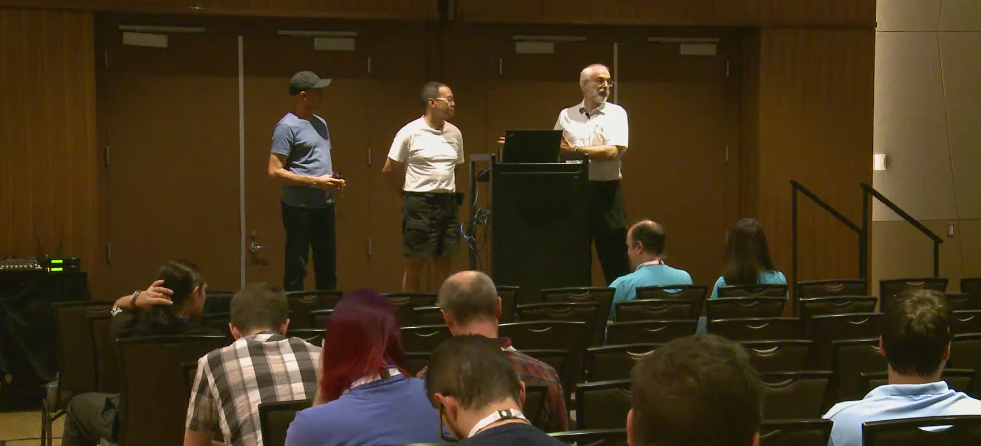
Memory Reclamation in C++ … for C++20
There is a draft proposal to add Hazard Pointers and RCU to an upcoming C++ standard. It’s the joint work of Paul McKenney and Maged Michael. This is like having Prof Xavier join forces with Magneto to bring down Apocalypse.
https://www.youtube.com/watch?v=uhgrD_B1RhQ

Slide 71
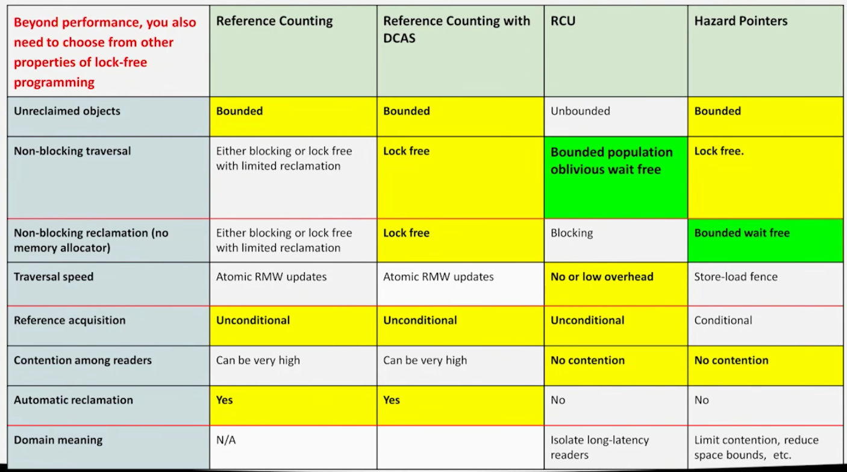
Memory Reclamation Comparison taken from the talk by Michael Wong + Maged Michael + Paul McKenney

Slide 72
References to more info
Can Parallel data structures rely on automatic memory managers?
http://safari.ece.cmu.edu/MSPC2012/erez_abstract.pdf
Why Concurrent Data structures are still hard
http://www.etaps.org/index.php/2014/invited-speakers#ESOP
There is an interesting post in kukuruku.ko with some details not mentioned here
http://kukuruku.co/hub/cpp/lock-free-data-structures-the-inside-memory-management-schemes
Are Hazard Pointers lock-free or wait-free?
http://www.concurrencyfreaks.com
Hazard Pointers vs RCU
http://concurrencyfreaks.blogspot.com/2016/08/hazard-pointers-vs-rcu.html
RCU proposal for C++
http://www.rdrop.com/~paulmck/RCU/RCU.2016.09.23b.CPPCON.pdf
Hazard Pointers proposal for C++
http://www.open-std.org/jtc1/sc22/wg21/docs/papers/2016/p0233r1.pdf

